Slide 1
Synchrony of Water Levels across the state of WI

Slide 2
Data
167 Wells and Lakes
12-15 Years of data (2001:2015)
Annual summer median value

Slide 3
Geography of synchrony
Dynamic Time Warping
Kernel K-means Clustering
Notes:
Finding patterns in a noisy environment is a significant challenge with this type of data.
We have collaborated with computer scientist and his solution was to draw on speech recognition algorithms, specifically dynamic time warping.
So instead of people saying "hey siri, what does limnology mean" and siri figuring it out, we feed the algorithm water clarity data and let it tell us how similar the patterns are.
We then use kernel k-means clustering to identify lakes with similar LT patterns, and finally fit a bayes common trend model to the data to indentify the different patterns.

Slide 4
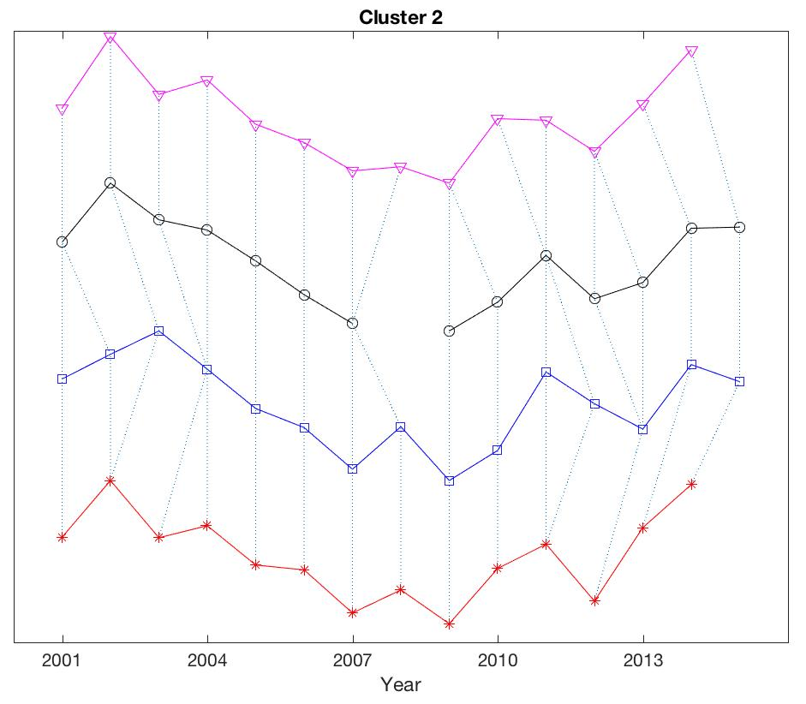
Dynamic Time Warping Specifics
Algorithm developed for speech recognition
Handles missing data
Align time series that are slightly asynchronous
Estimates a difference/similarity metric between time series that can be used to identify suites of time series with similar long-term patterns
Used a DTW window of +/- 2 yrs
Notes:
DTW plot shows 4 time series from cluster 2 which all have a U-shaped pattern (high in 2001, low in 2008, and recovery by 2015) which is characteristic of the patterns in northern WI. The dashed lines show how the DTW algorithm is aligning individual and potentially asynchronous points between each time series. D

Slide 5
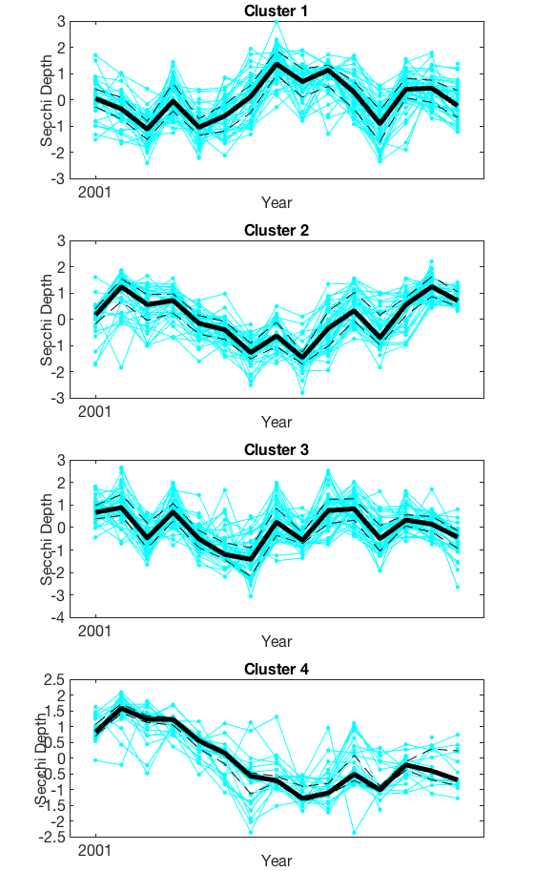
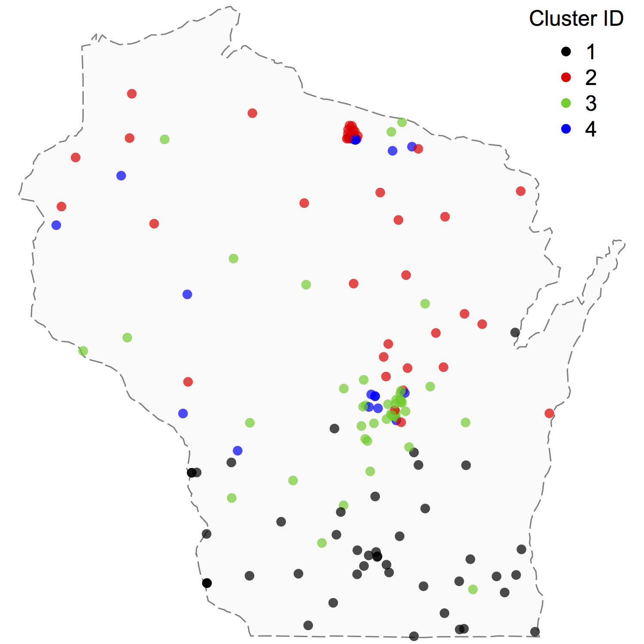
Standardized water level

Slide 6
What landscape/climate factors can help us predict long-term water level patterns
Predictor Variables
Record Type
Lake vs. Well
Spatial
Lat/Lon
Landscape
Landcover/landuse @ HU4, HU8, HU12 spatial scale
Gelology
Surficial soils @ HU4, HU8, HU12 spatial scale
Climate (30 yr normal values)
Precipitation, runnoff, baseflow, groundwater recharge @ HU4, HU8, HU12 spatial scale

Slide 7
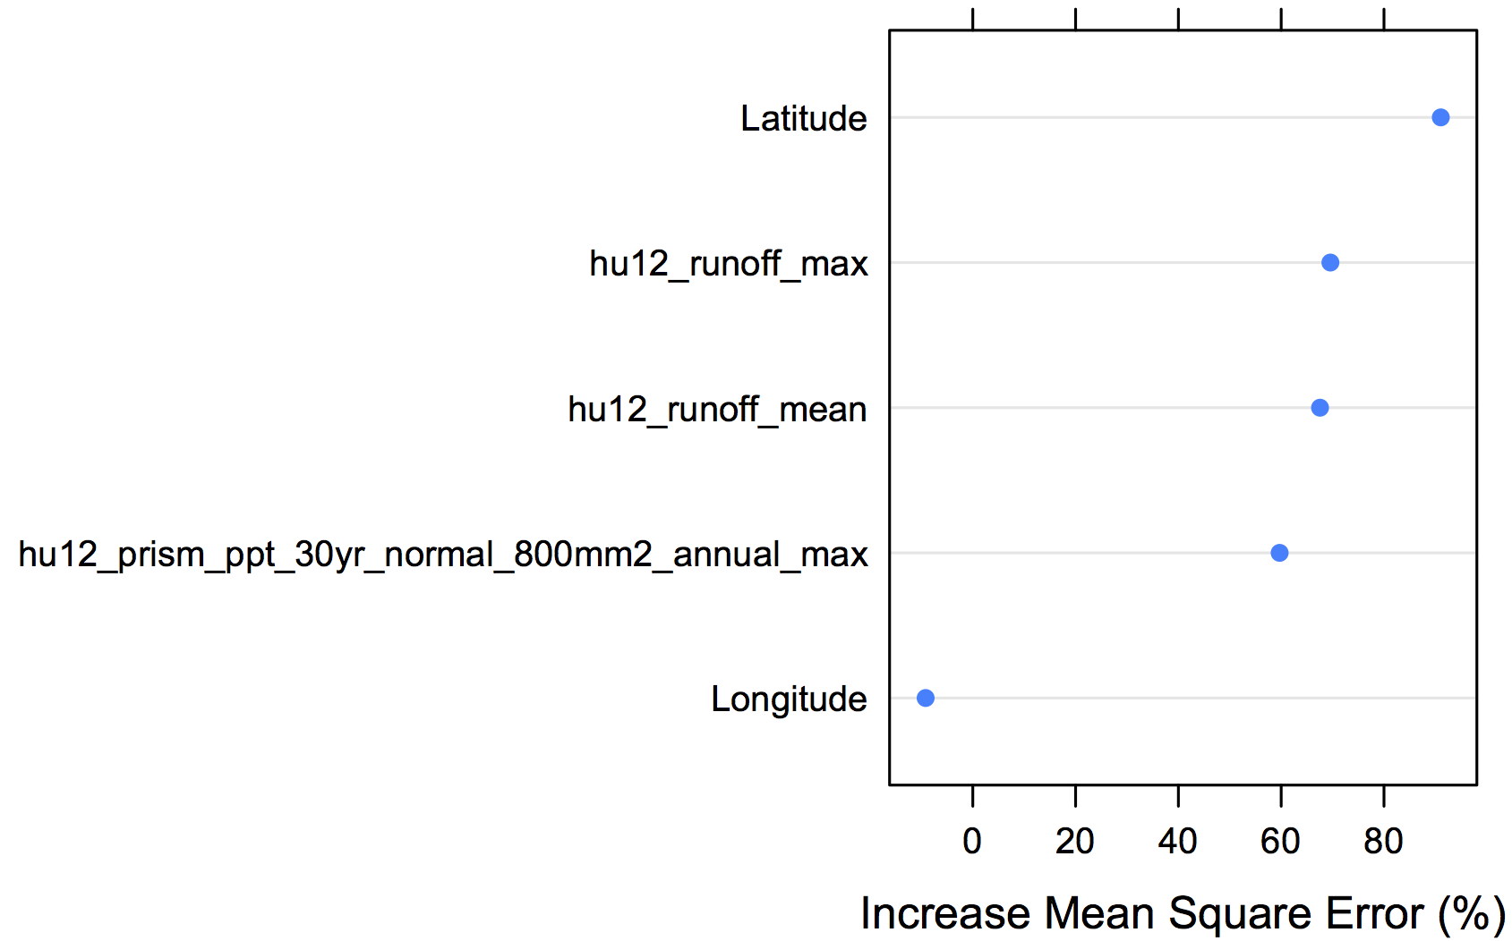
Results from Random Forest Classification Models
Correctly classify 75% (68% – 82%) of sites
Variable selection suggests 5 important variables for interpreting the results

Slide 8
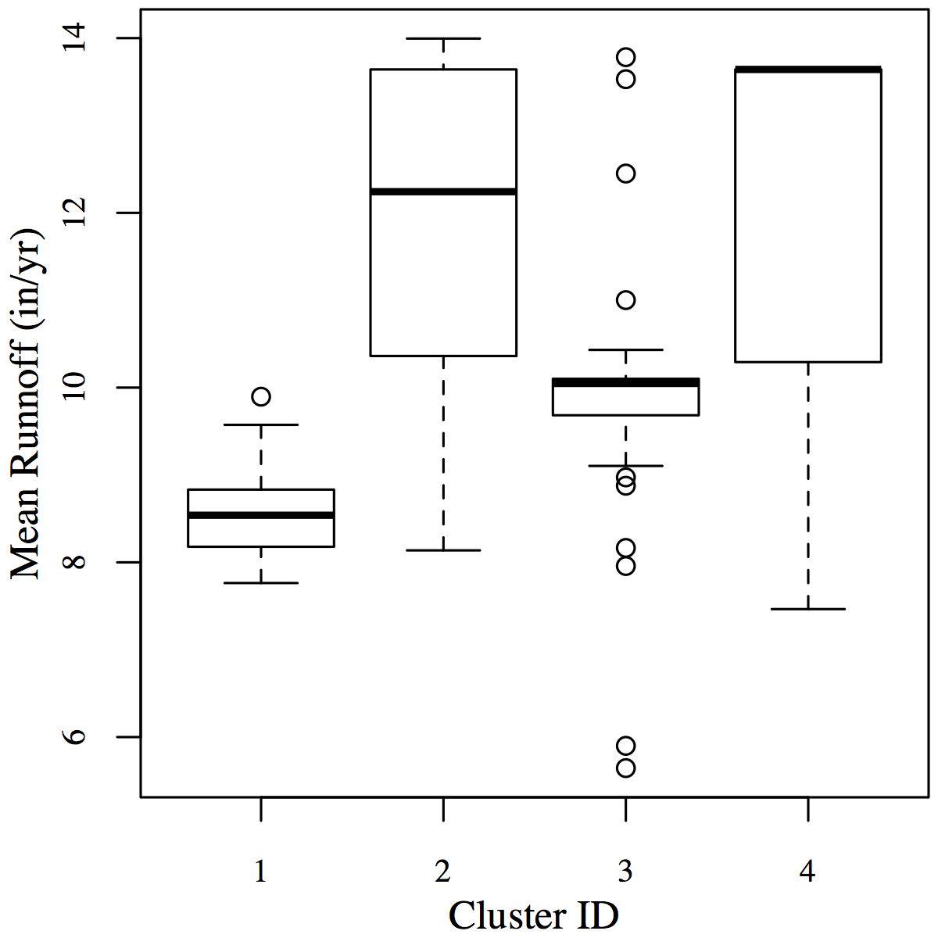
Standardized water level NOT secchi depth

Slide 9
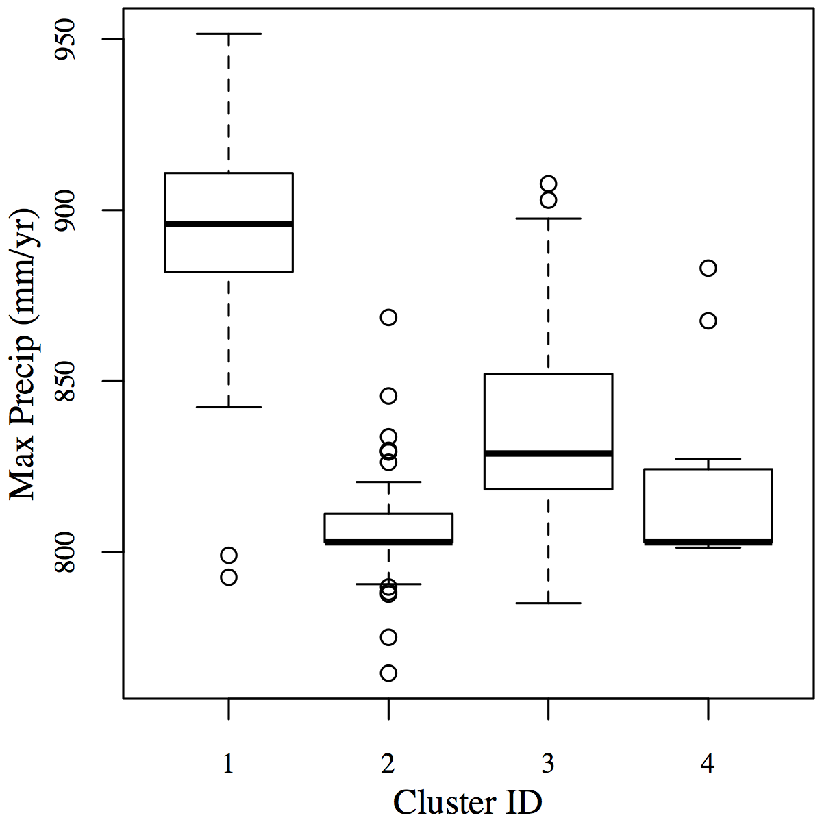
Standardized water level NOT secchi depth

Slide 10
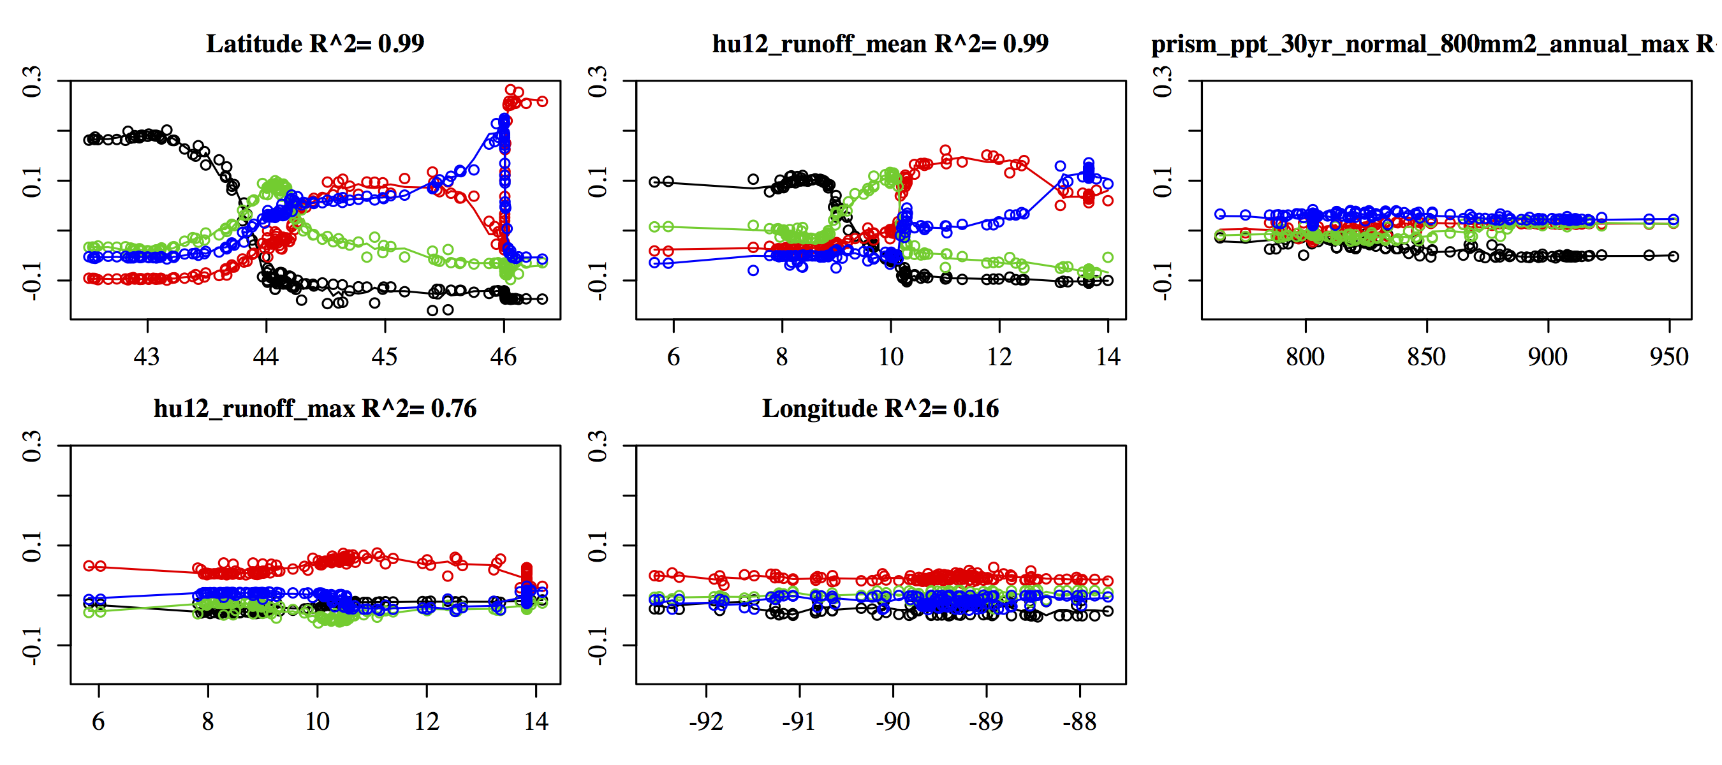
Partial Dependency Plots
X axis is change of predicted probability due to variable value

Slide 11
Take Home Message
North/South gradient in water level patterns
Dividing line is around the central sands area
Lakes and groundwater levels do not have significantly different patterns across the state
Runoff and Precipitation can explain ~50% of the clusters
These are at the HU12 scale so local dynamics
Including latitude increases accuracy by 25% (thus we are still missing a significant predictor in our model)
Likely some variable operating at a larger spatial scale

